Slide 1
Programmer’s Date
Team BITSians

Slide 2
PROBLEM STATEMENT
Track a Bed
A web application using HERE Maps to track the nearby hospitals around us.
The application will be connected to the hospital's database, and give us information about the availability of beds and facilities in that particular hospital.

Slide 3
IDEA
A Load Balancer, based on treatment resources available at the disposal of various medical units around the patient’s location, aimed at optimizing to make most effective and efficient usage of these healthcare facilities.

Slide 4
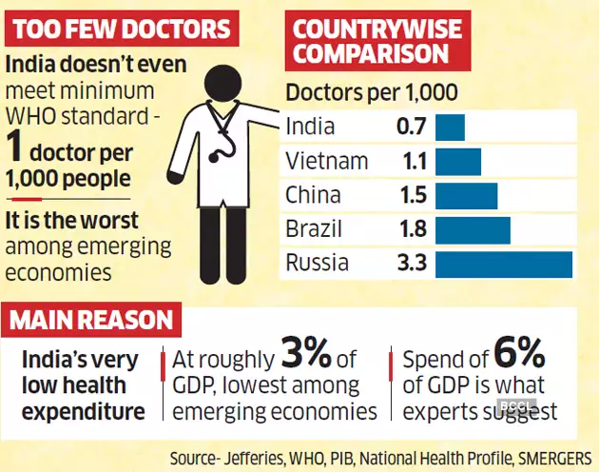
MOTIVATION FOR THE IDEA

Slide 5
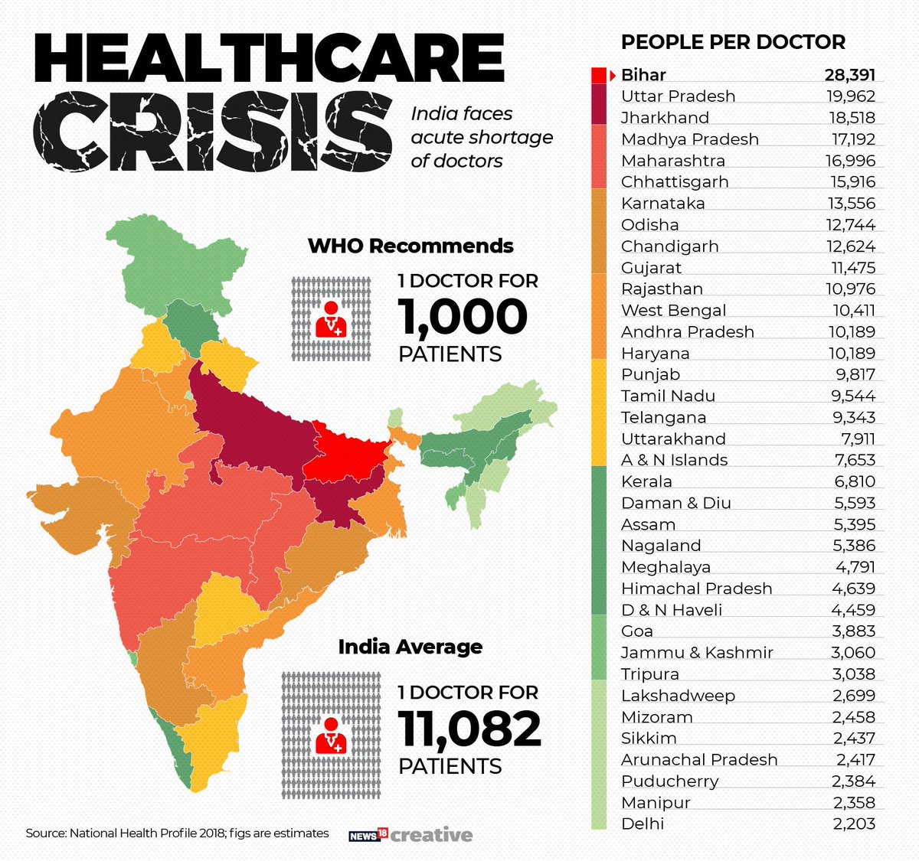

Slide 6
People per Doctor Statistics clearly show that India lacks the resources and infrastructure to deal with the COVID-19.
So we wanted to find a way to optimize the Resource allocation ahead so that current resources are utilized adequately without causing mayhem.
Because COVID-19 is a contagious virus that can spread quickly and visiting the hospital for some data doesn’t make sense, at least during the pandemic.
In case of emergency, finding free beds and hospitals is difficult, but having the information beforehand can be useful.

Slide 7
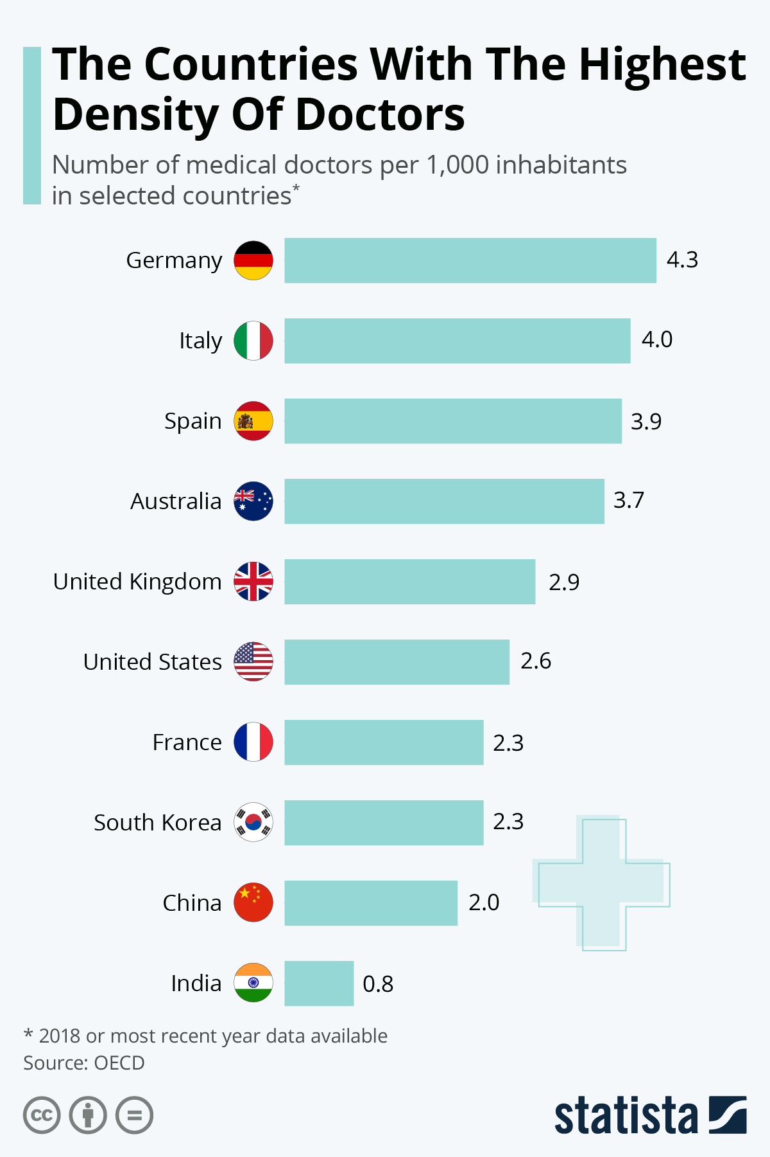
Only few countries meet WHO recommendations

Slide 8
APPROACH TOWARDS IDEA
Mapping of all data points that can be updated in real-time on the map to provide accurate information to the patient.
Routing to best (fastest + nearest) possible medical facility available to the patient.
Locating all emergency health units to the user.
Medical facility based search, to meet the exact need of the user.

Slide 9










TECH STACK

Slide 10
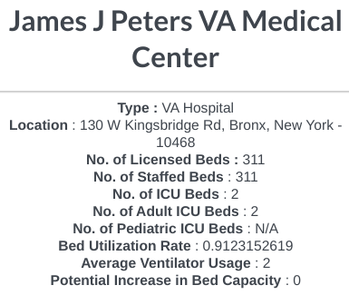
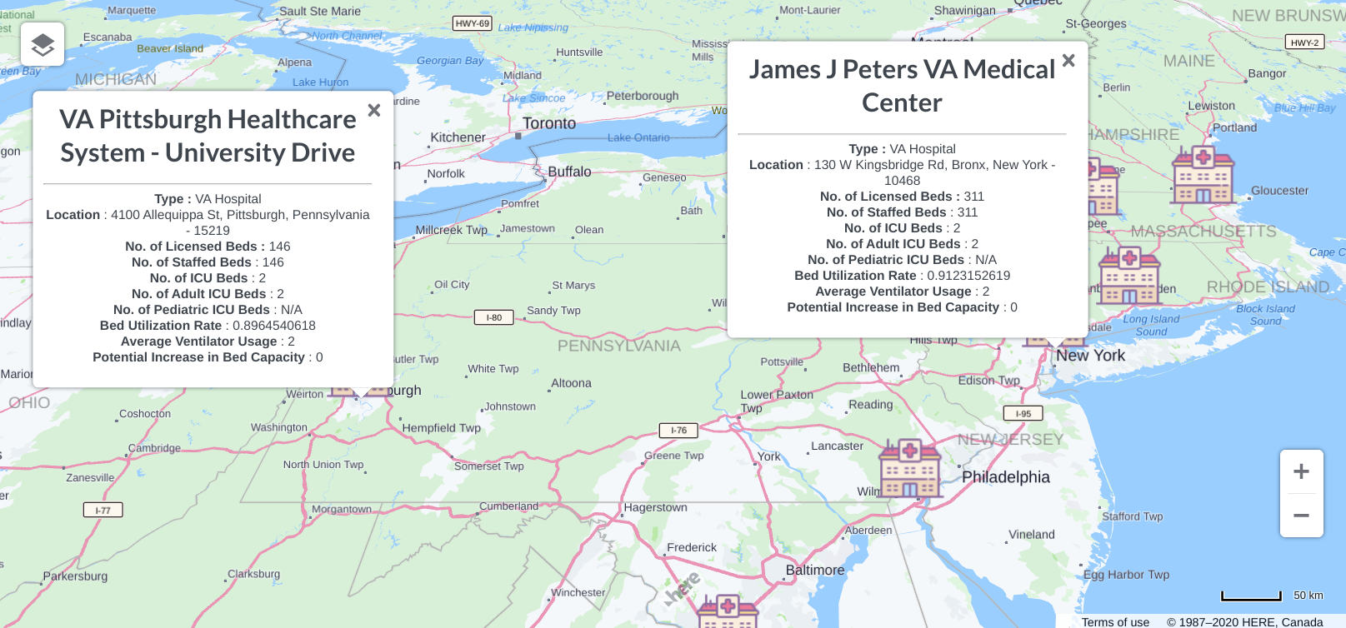
FEATURES
Add Data Points : Places marker on coordinates from the database with all bed and ventilator related info.

Slide 11
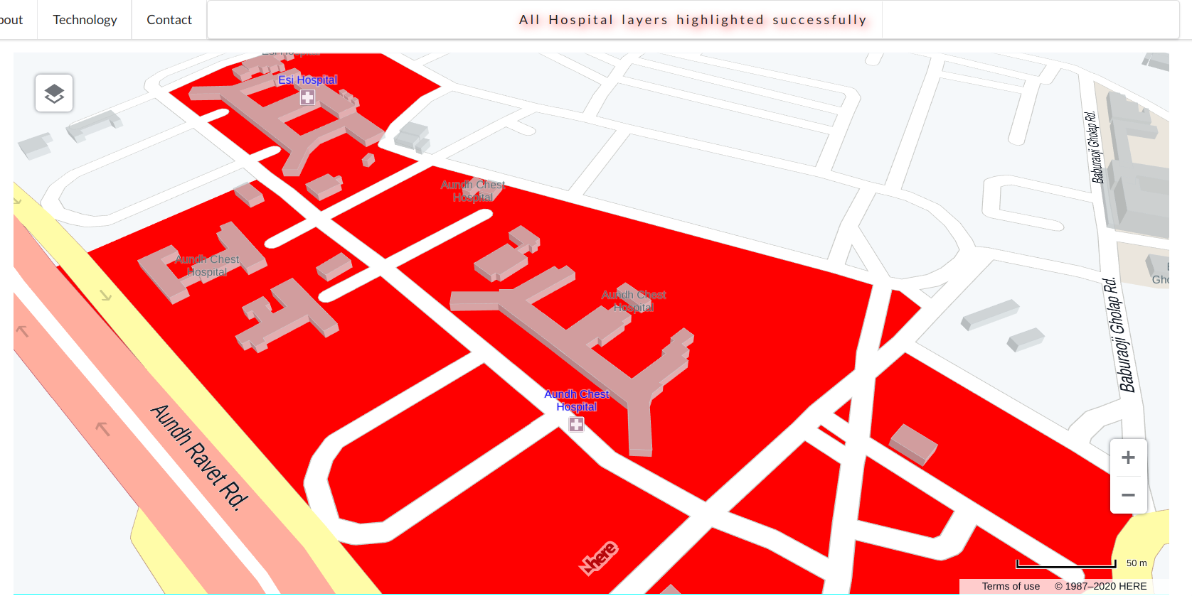
Highlight Hospitals : Helps in tracking nearest medical or healthcare service. Very useful in times of emergency.

Slide 12
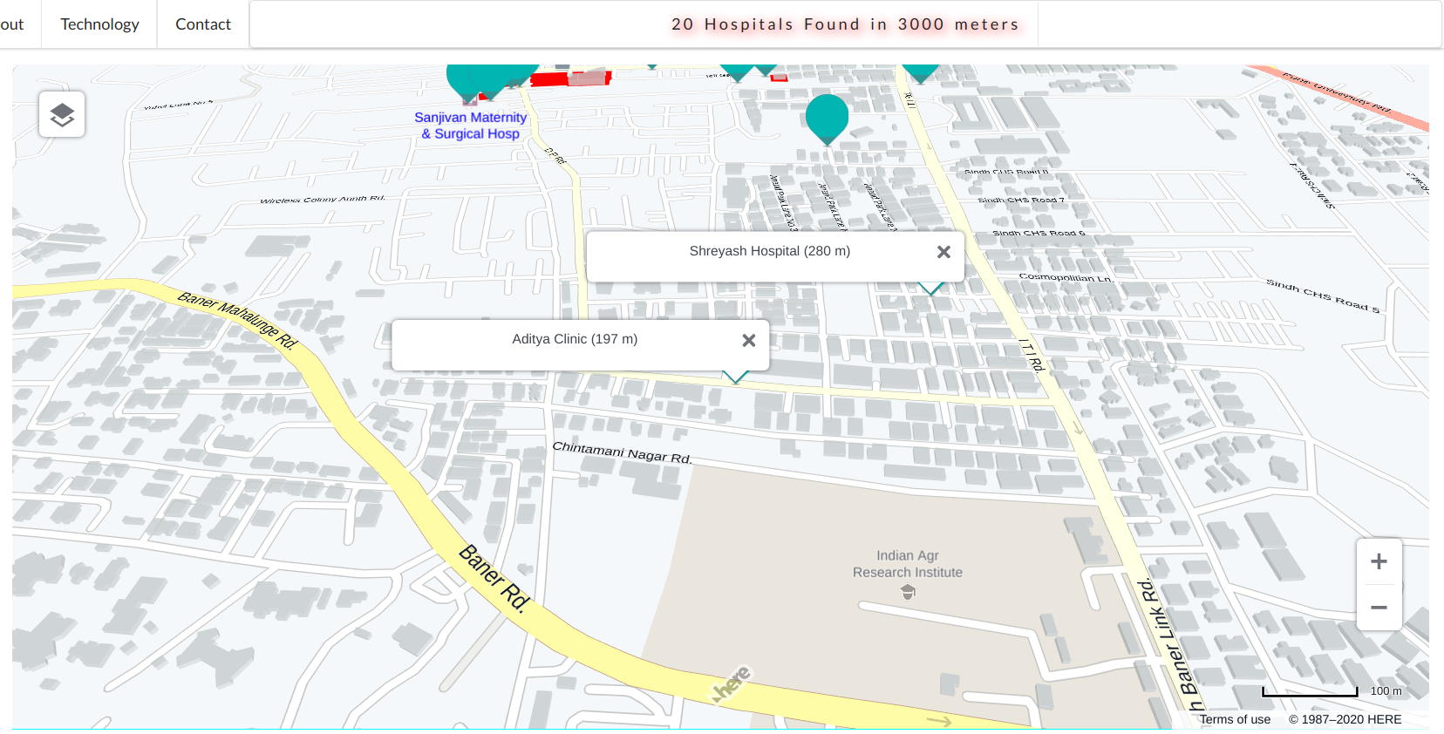
Discover Hospitals : Helps in finding the nearest hospital to whatever part of the map you’re looking at. Configured to calculate nearest from center of map. Required : Radius of Search (in mts).

Slide 13
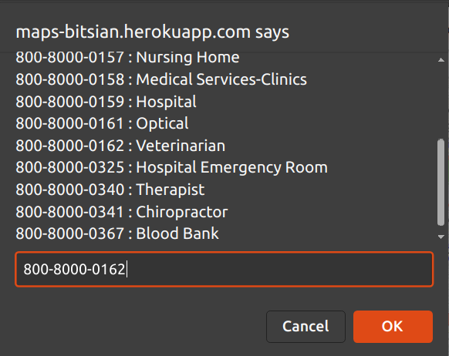
Advanced Search : Helps in finding best (nearest + fastest) medical services based on user input and preference. Required : Type of medical service.

Slide 14
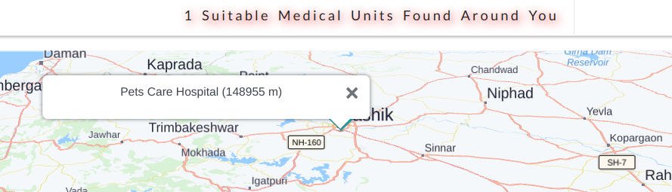

Slide 15
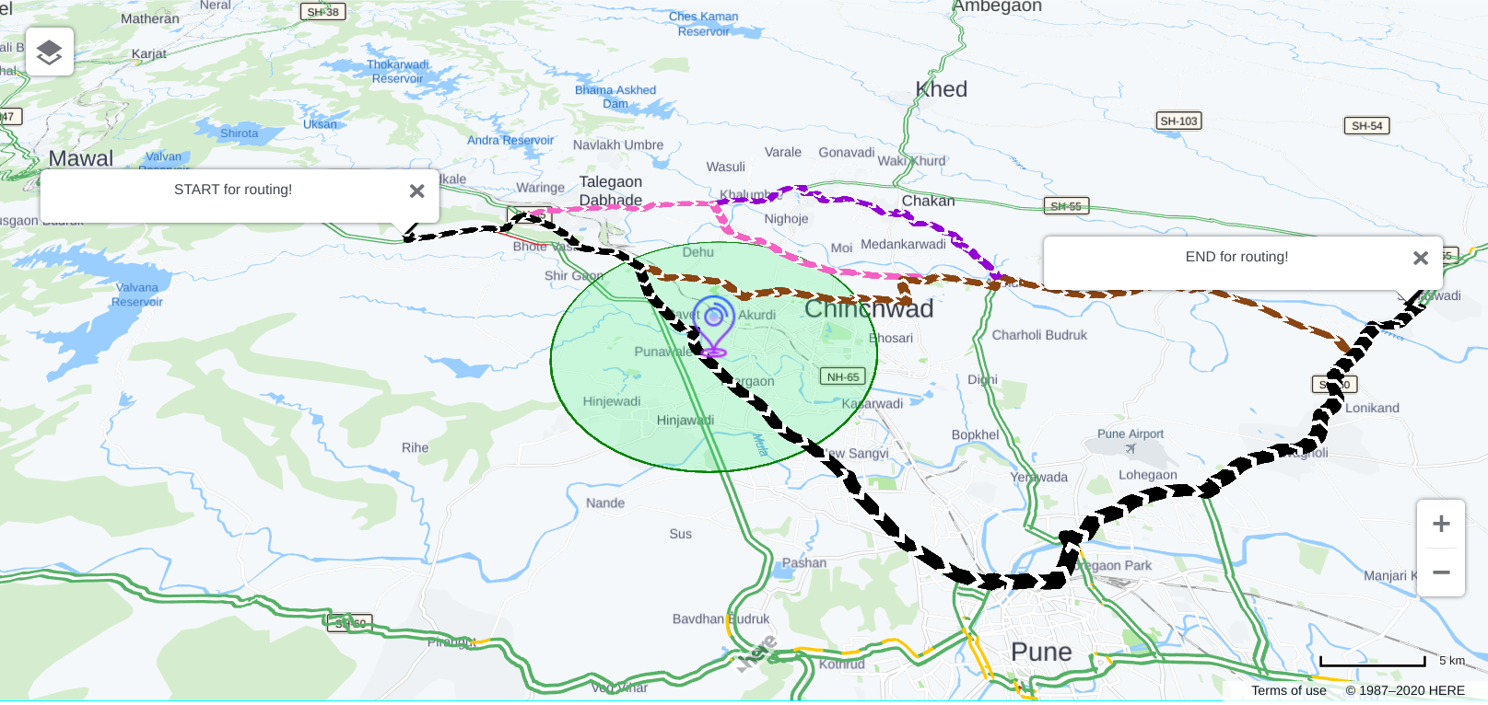
Dynamic Routing : Accepts input for start and end point from user and routes best possible alternative(s). Also, changes layer of map to show traffic.

Slide 16
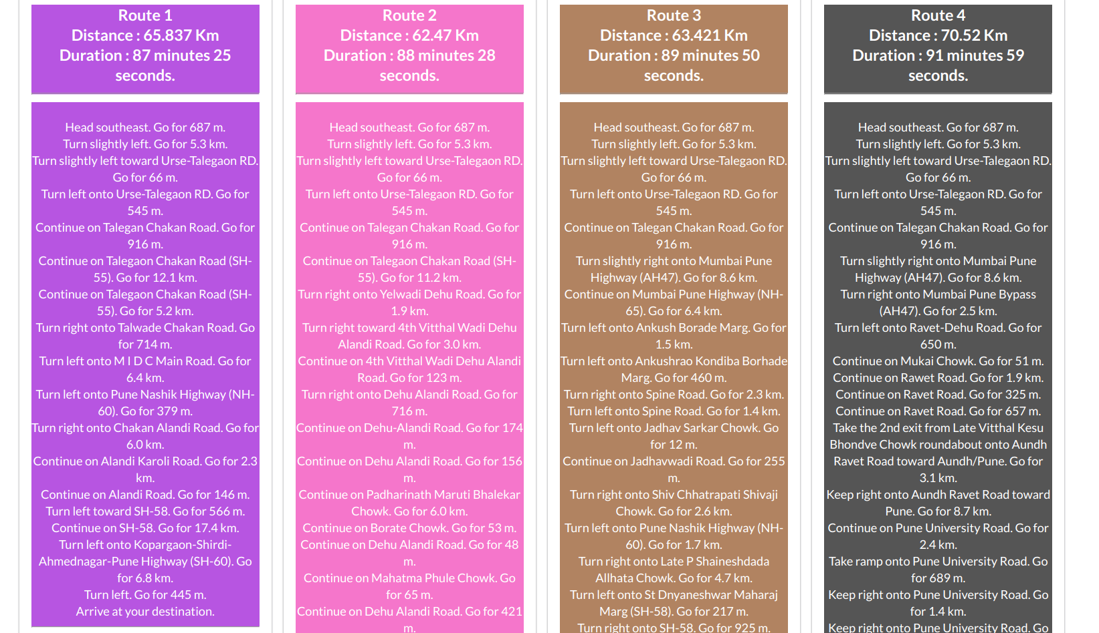

Slide 17
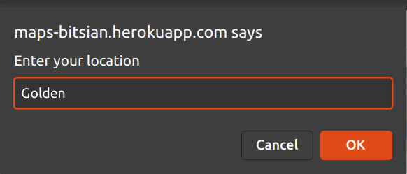
Search : Marks search result(s) on the map. Required : Name of the place. [currently restricted to US - to provide best results + small dataset of hospitals available]

Slide 18
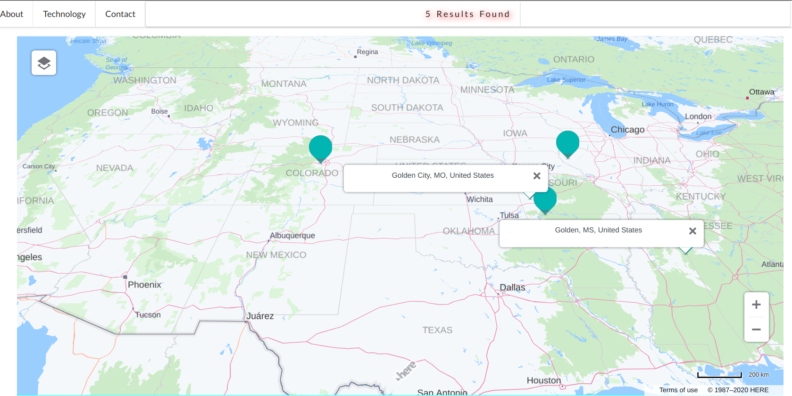

Slide 19
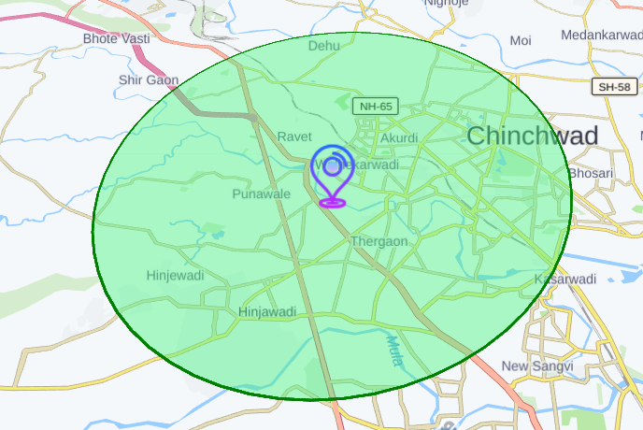
My Location : Pushes GPS marker to your location + centers the map.
Live Status : Click anywhere on the map to get title of the position. Also, used to display other statuses.

Slide 20
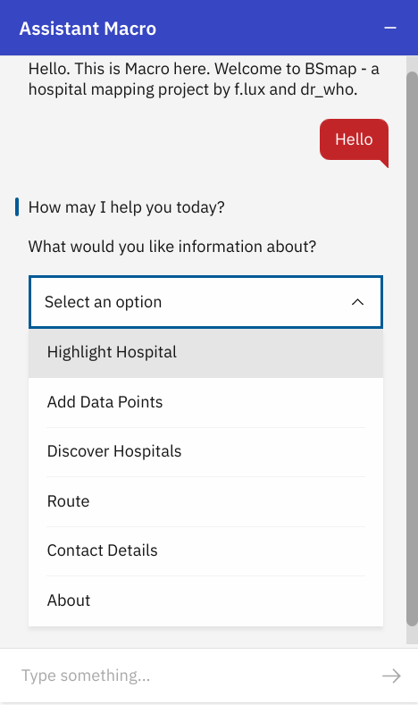
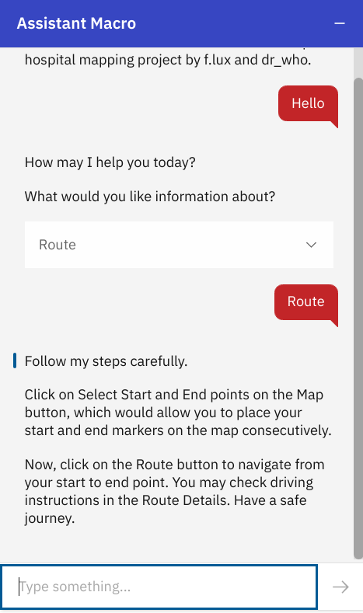

Assistant Macro : An AI based bot that helps user to guide through different features and functionalities of the application. Found at the bottom-right corner of the webpage.

Slide 21
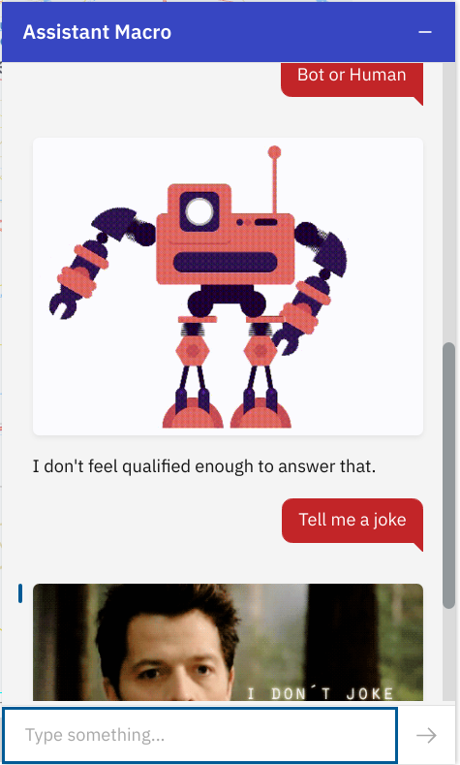
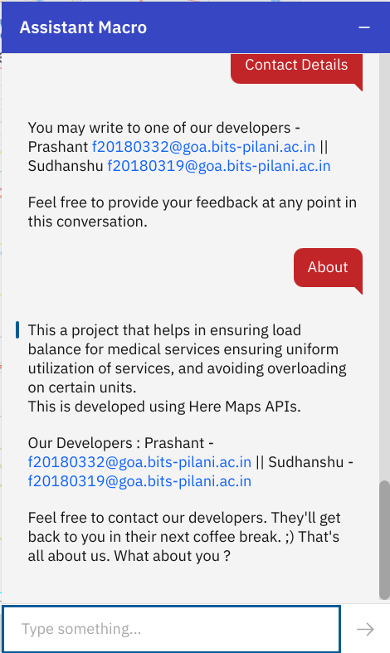
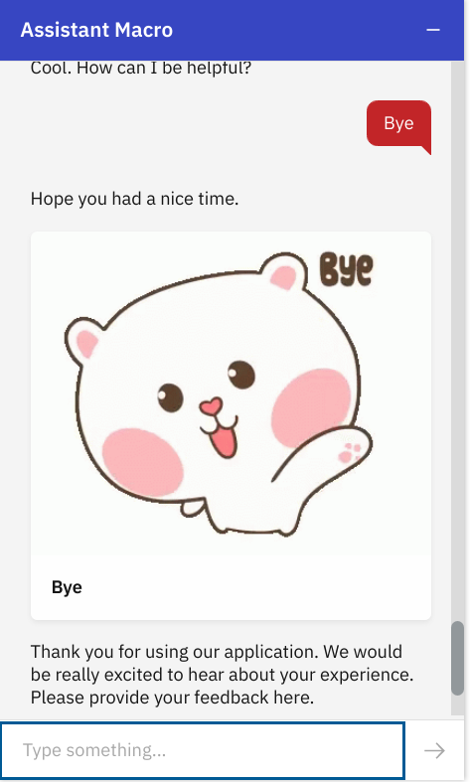

Slide 22
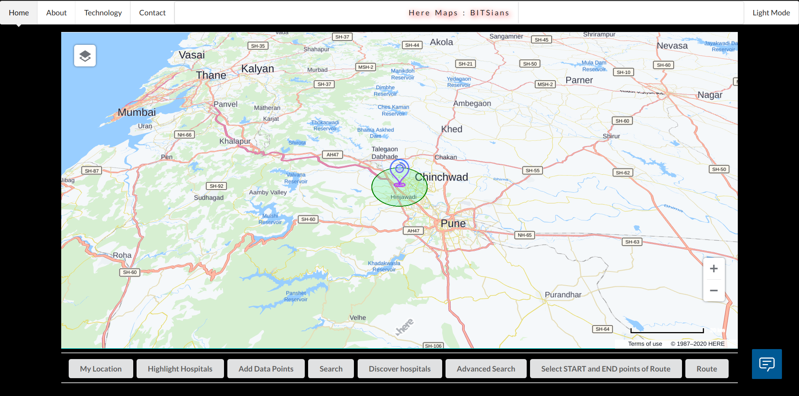
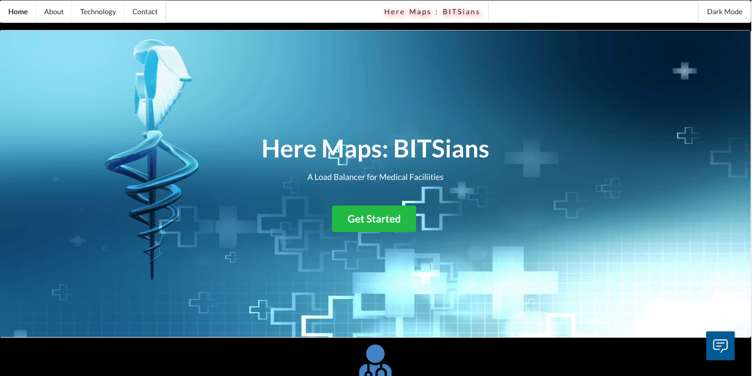
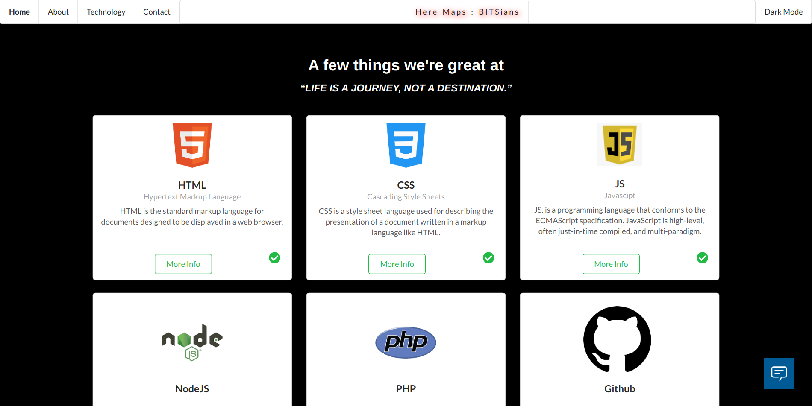
Dark Mode : Makes it easier for the user to visit the webpage in dim light without adding extra strain on the eyes.
Toggle between Dark and Light Mode available at the top right corner of the page.

Slide 23
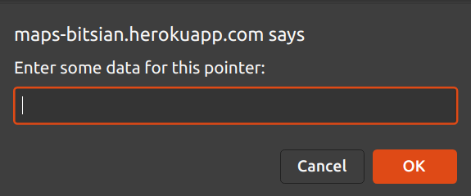
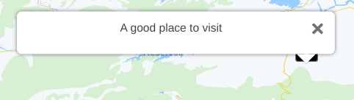

User Markers : Dynamic Markers with user defined data. Draggable + Custom + Dynamic.
Activates / Adds with a long click / tap on the screen.

Slide 24
Responsive UI/UX

Slide 25
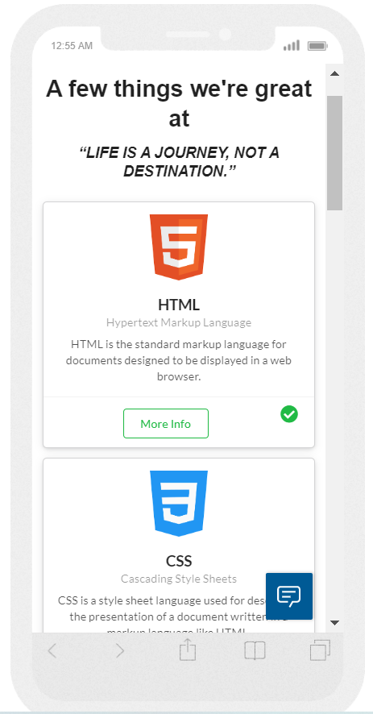
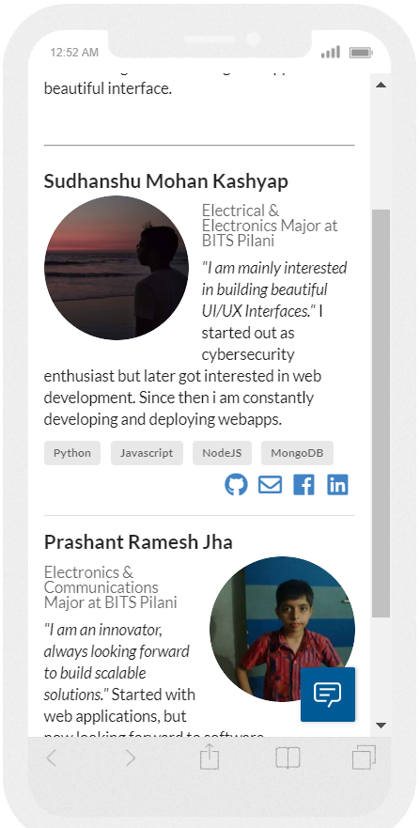
Responsive UI/UX
Beautiful Responsive Design
Adjust according to device
Whether an android an iphone or an ipod it automatically adjust itself

Slide 26
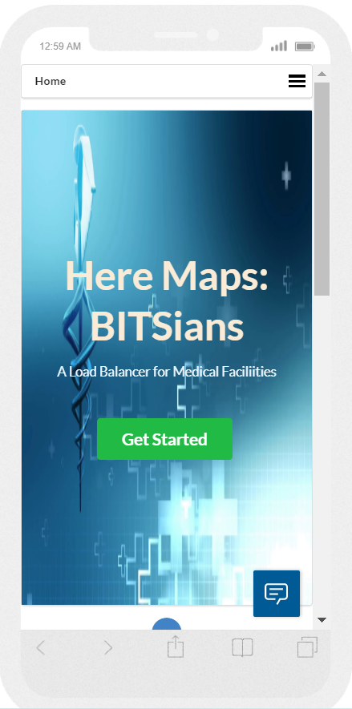
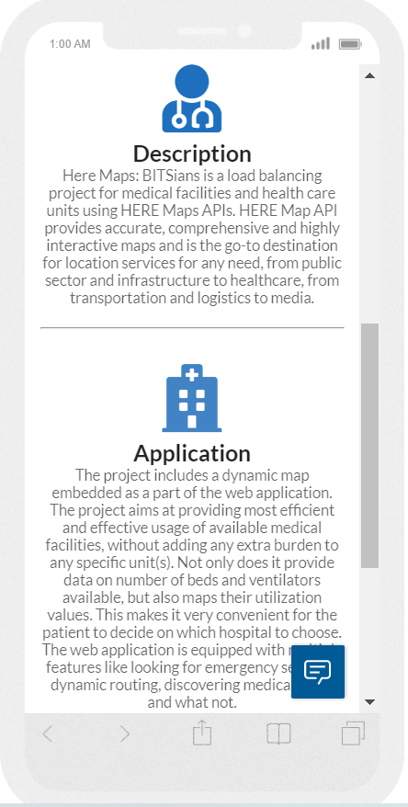
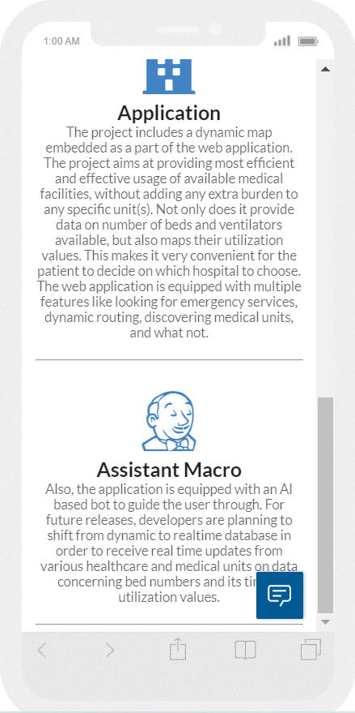

Slide 27
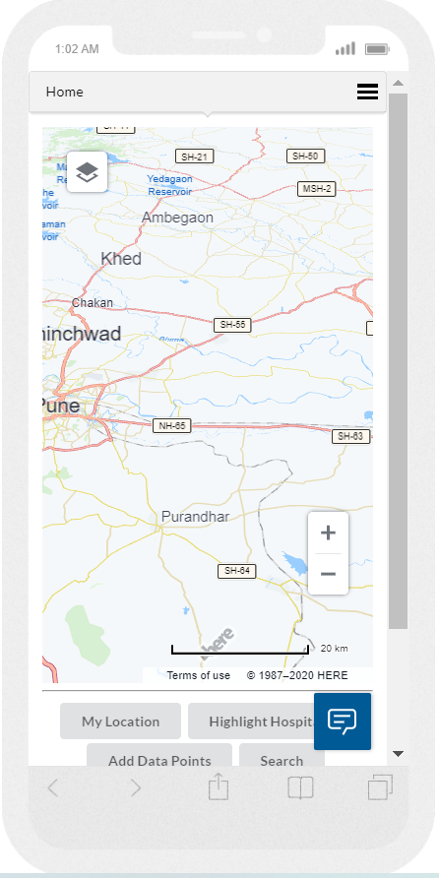
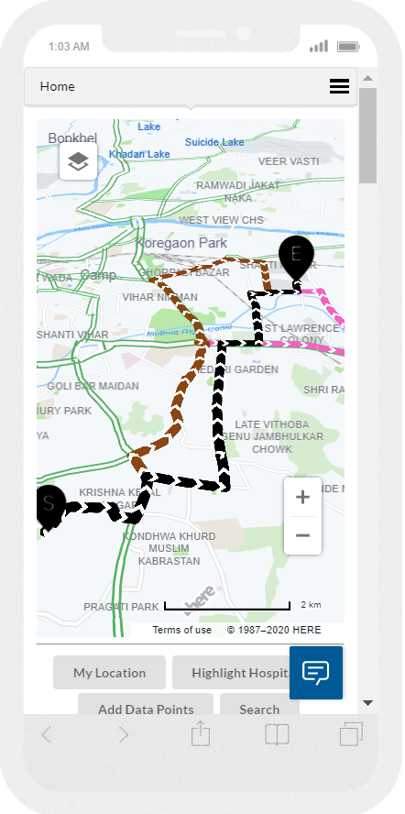
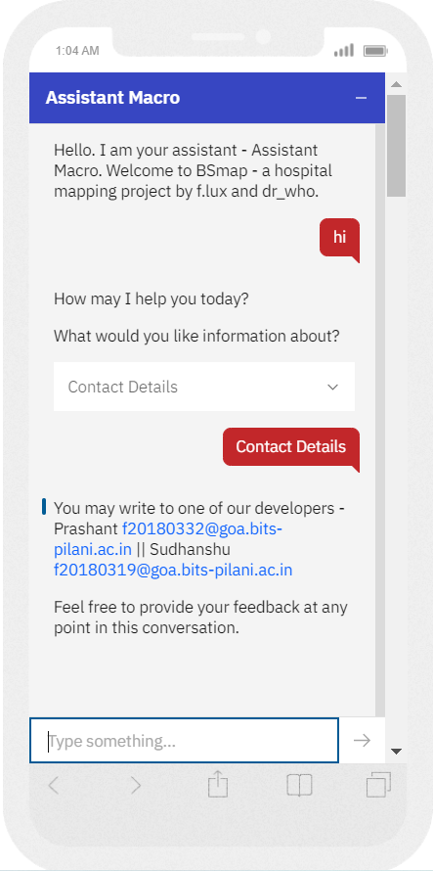

Slide 28
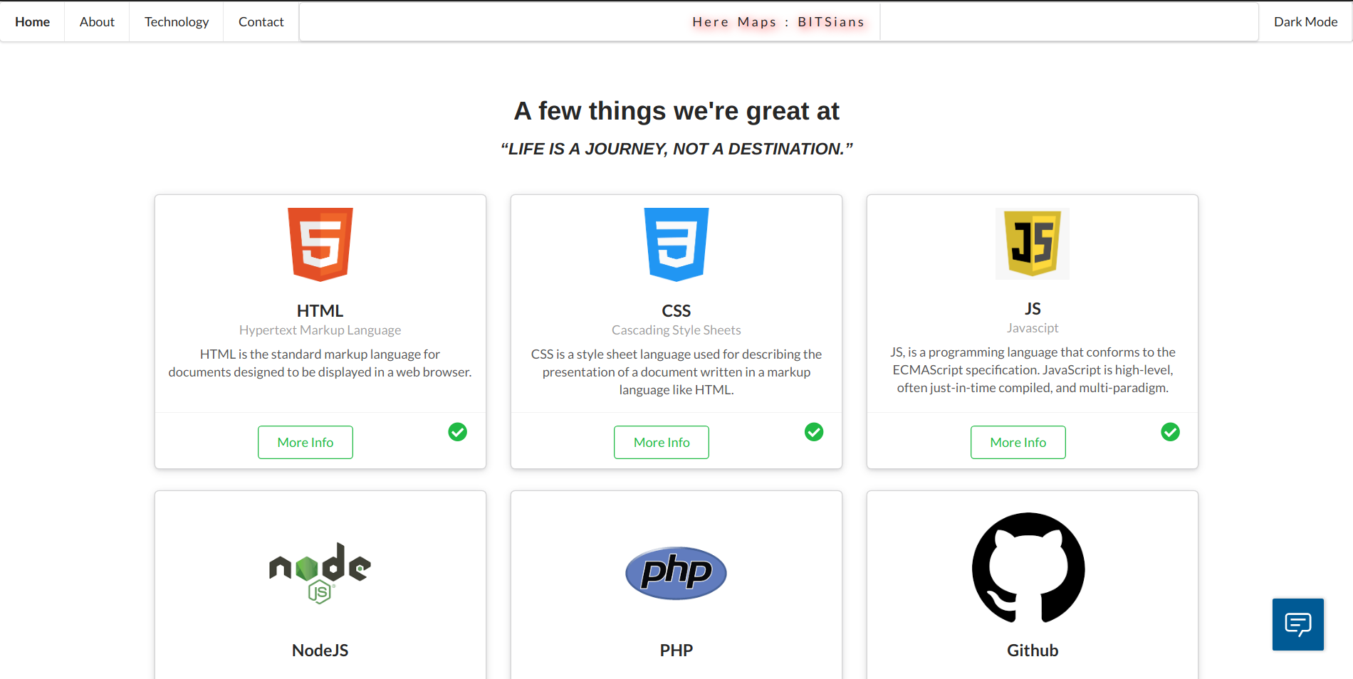
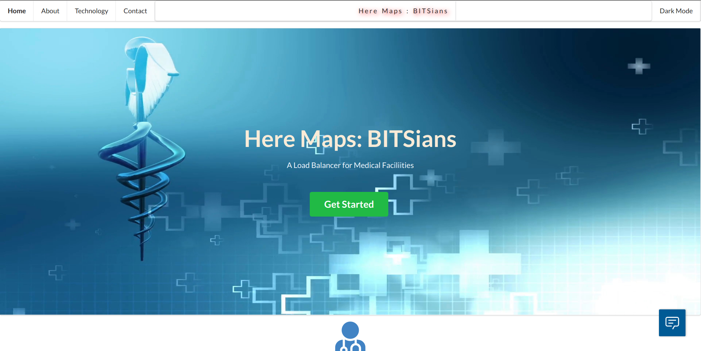
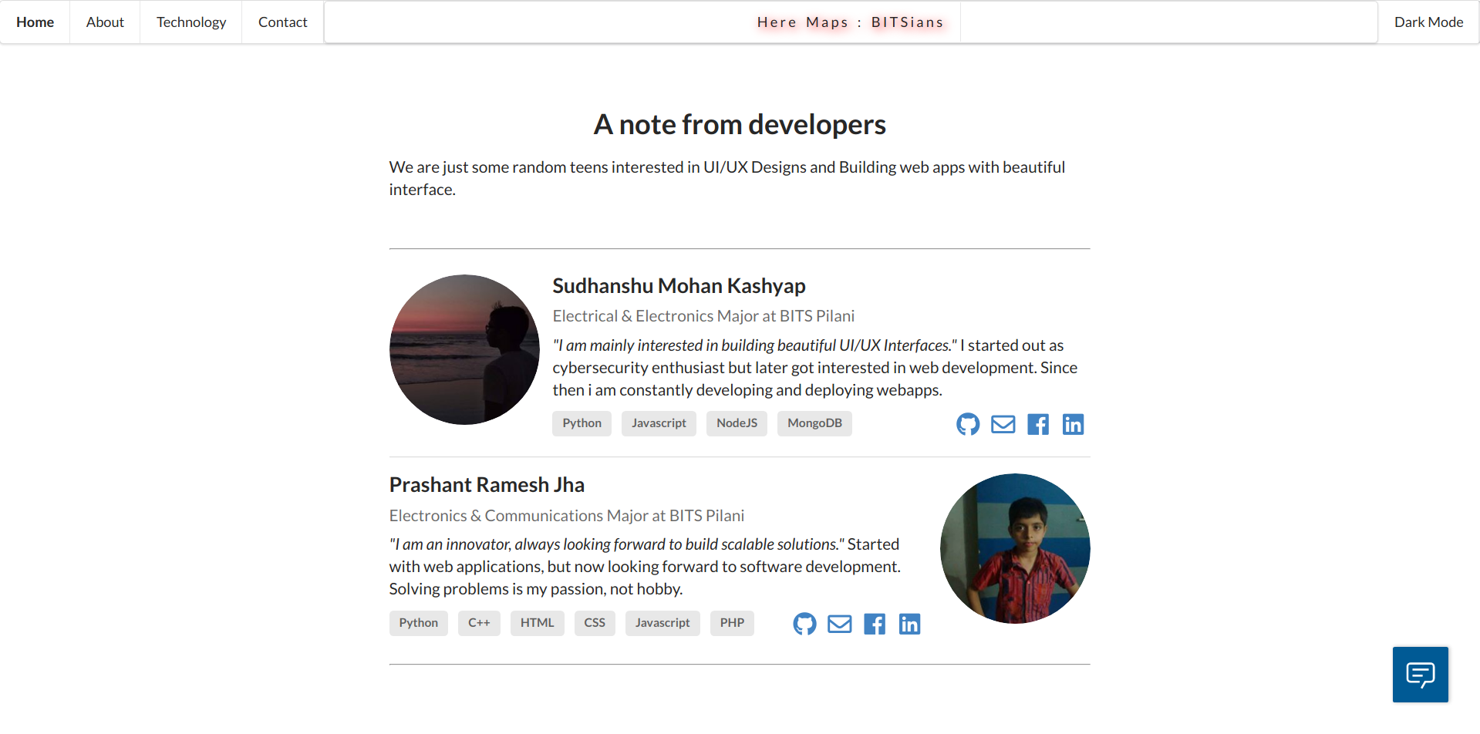
Misc Pages
About
Technology
Contact

Slide 29
Link to project :
https://maps-bitsian.herokuapp.com/
Link to Video Demonstration :
https://youtu.be/dM-3TJw0hH4

Slide 30
Q&A

